Slide 1
Jmeter with Jenkin System
The old system which was made by Mr. Man

Slide 2
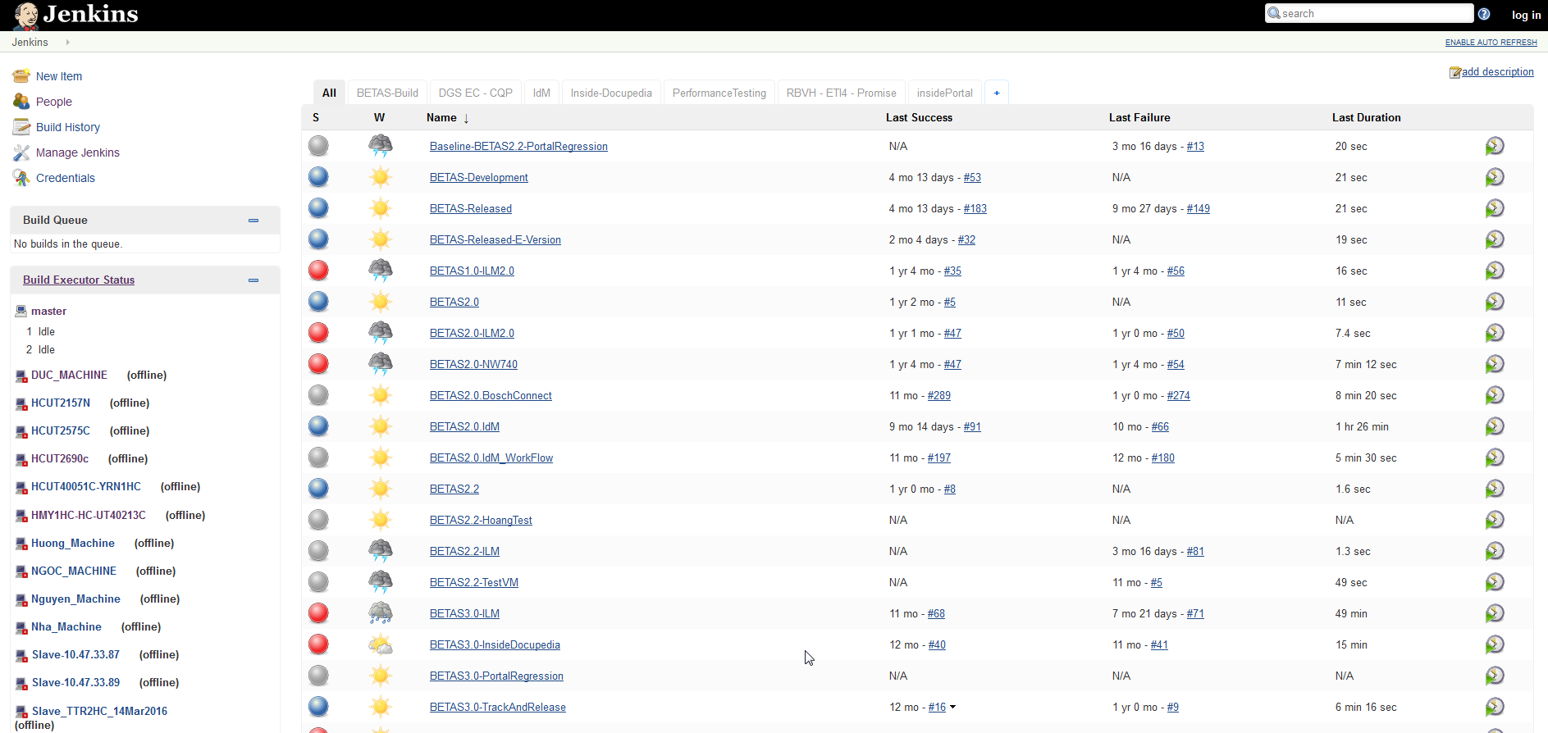
http://hcut2694c:8080/
- The Home link of Jenkins system which was host in Mr. Man Computer

Slide 3
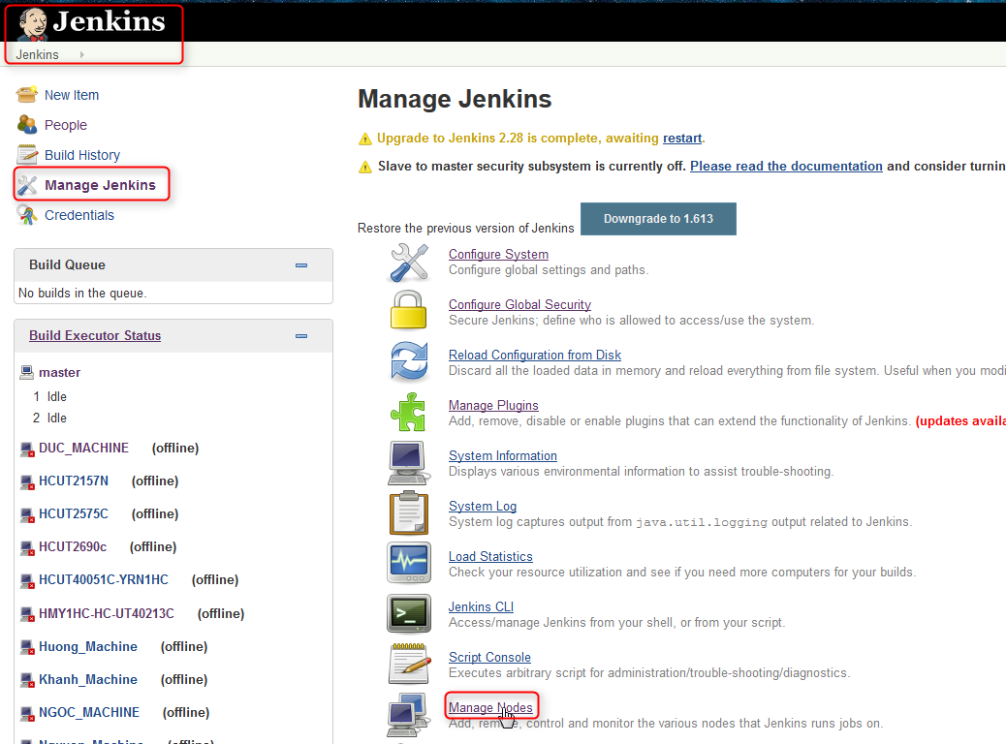
Making Node and Connect Your Computer with Jenkin
1. Go Back to Jenkins Homepage
2. Click on Manage Jenkins
3. Click on Manage Nodes

Slide 4
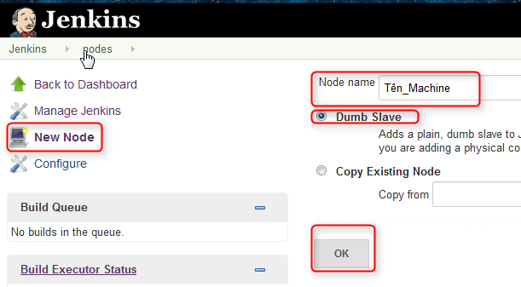
Making Node and Connect Your Computer with Jenkin
5. Name Your Machine and choose Dumb Slave
4. Click on New Node
6. Click Ok button

Slide 5
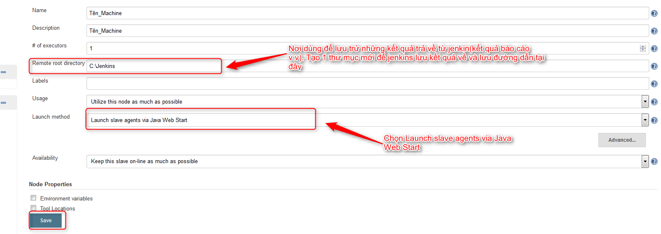
Making Node and Connect Your Computer with Jenkin
8. Fill Out this Information

Slide 6
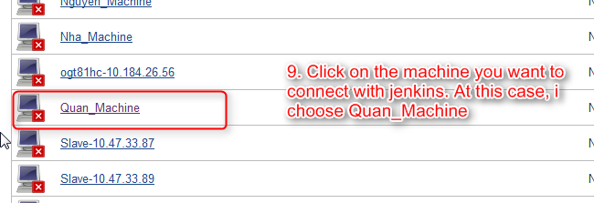
Making Node and Connect Your Computer with Jenkin

Slide 7
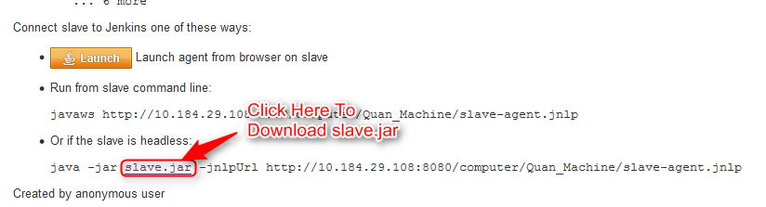
Making Node and Connect Your Computer with Jenkin
After download slave.jar, locate to the folder where store that file. Open CMD, and run the Command line which I underline just like the picture above

Slide 8
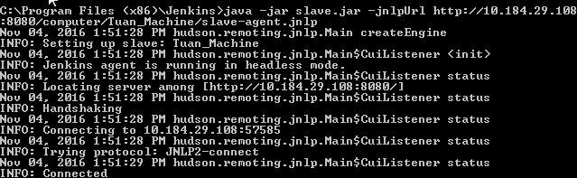
Making Node and Connect Your Computer with Jenkin
If you see INFO: Connected, it means that you are connected.

Slide 9
http://hcut2694c:8080/
- The Home link of Jenkins system which was host in Mr. Man Computer

Slide 10
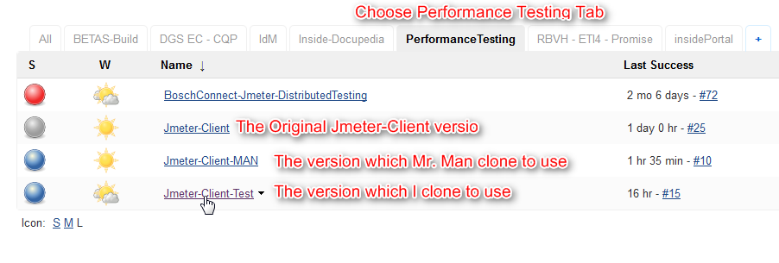
Where the Jmeter-Client Store in.
You can use the version “Jmeter-Client-Test” for testing or you can easily clone a new-one for yourself by following the instruction in slide 11

Slide 11
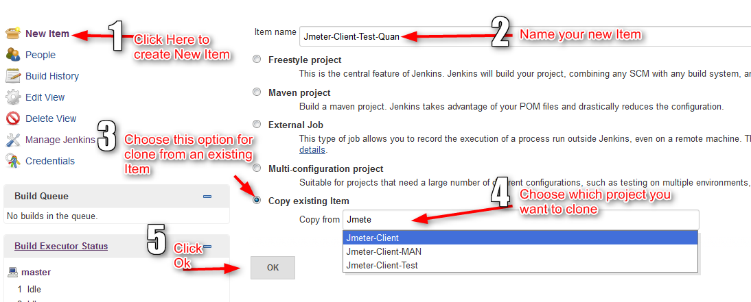
Clone a new-version for your-self

Slide 12
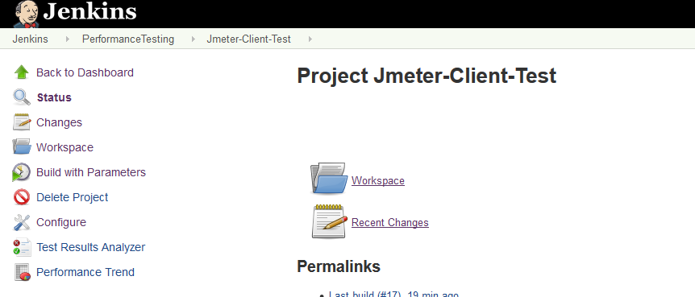
Start a Jmeter Test
In this case, I use the project “Jmeter-Client-Test” to start a new test. You can choose this project to test or create your clone project to test

Slide 13
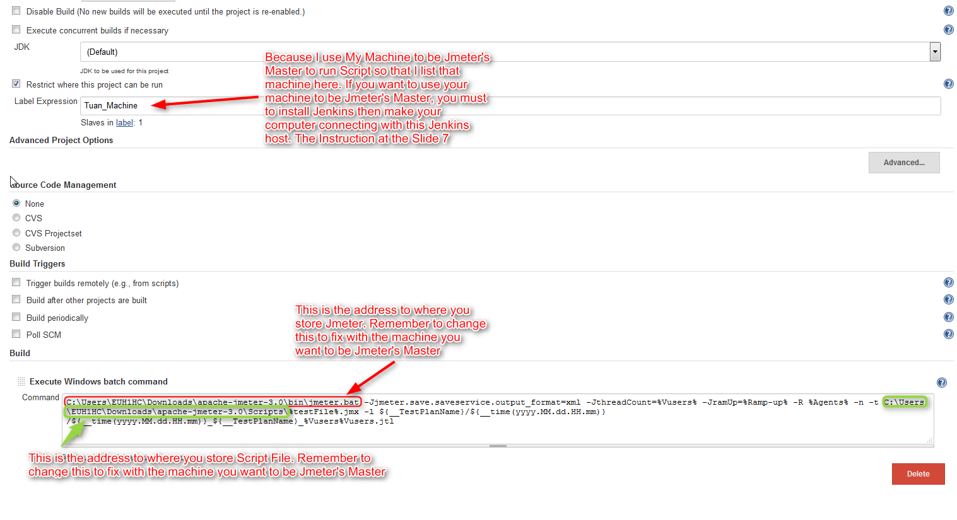
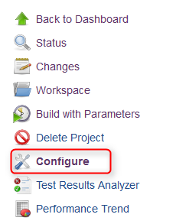
Configure To Run
There are 2 specific properties that you have to notice. Remember to change it to fix with the machine you want to be Jmeter’s Master
Then Click save.

Slide 14
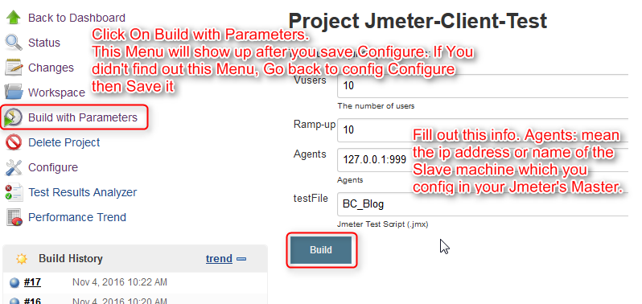
Start a New Test
Click Build to run test.
Remember: You must start Jmeter-server.bat at the Jmeter-Slave machine to run this test. At this case, I put 127.0.0.1:999 at Agents it means that I use my machine also a Jmeter-Master and a Jmeter-Slave

Slide 15
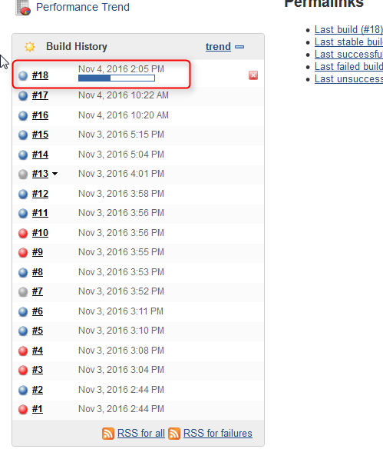
Start a New Test
When Your test are running, The status about your test will show out at the build History table at the left side. Click on that Test to see the result of that test.

Slide 16
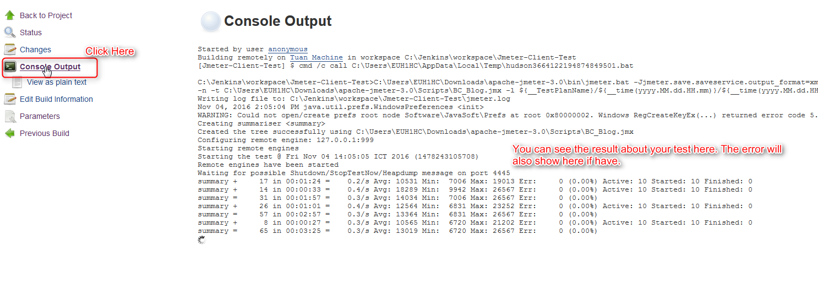
Start a New Test

Slide 17
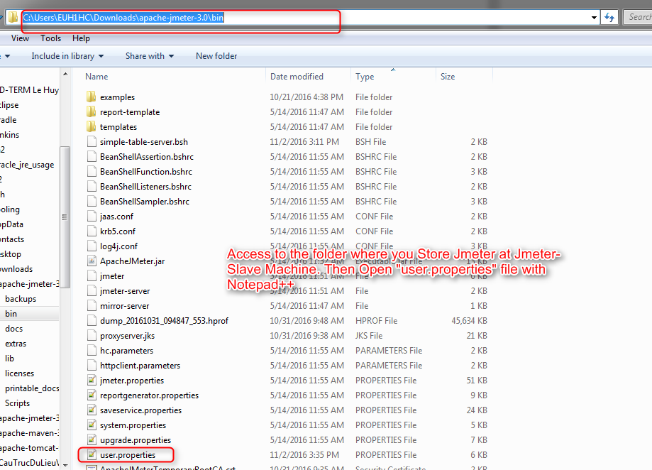
Config Jmeter-Slave to run
Add this line at the bottom of “user.properties” file
server_port=999
mode=Standard
Then Save.

